Slide 1
Loose Balloons
Frog’s the Name and Toad’s Retort
Read
Talk about their differences

Slide 2
Handouts for everyone 2 Poems
Read “Frog’s the Name and Toad’s Retort”
Have students discuss when was the first time they saw or heard a frog or a toad?
View and listen to 10 northeast frogs
Pick-a-Frog to write about
Sh

Slide 3
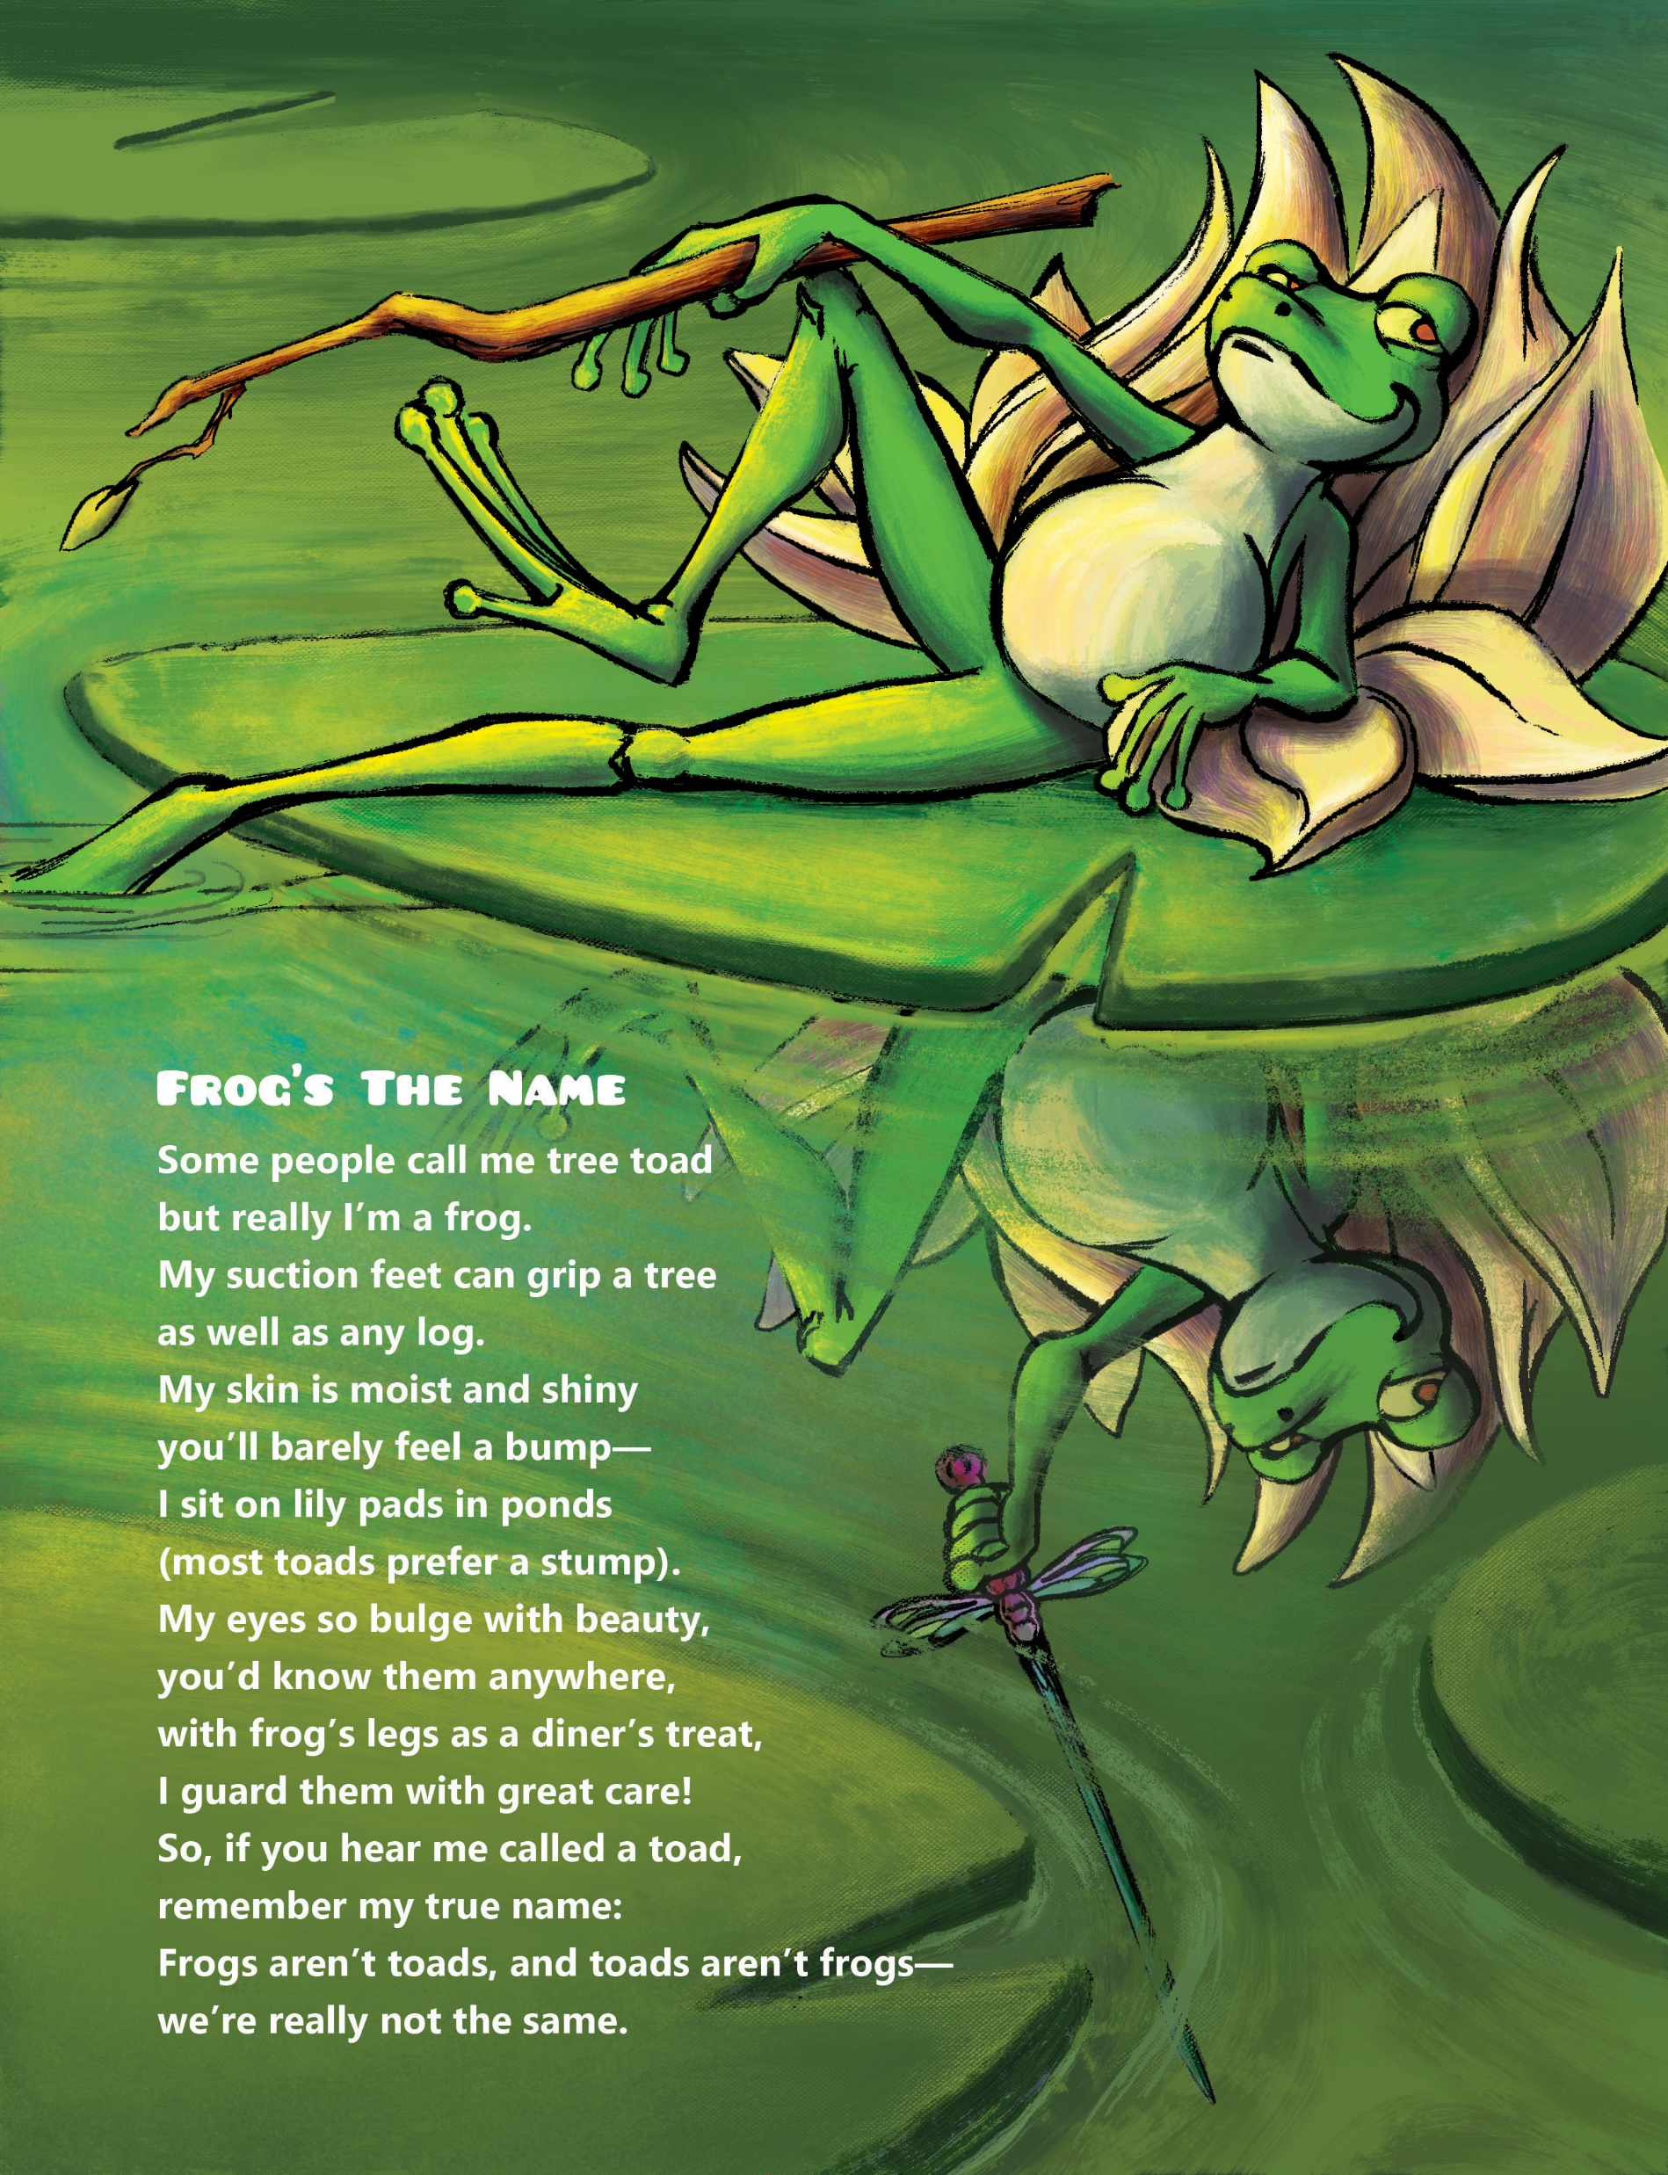

Slide 4

https://Wonderopolis Frogs northeatern with sound.com/calls-of-frogs-and-toads-of-the-northeast/

Slide 5


