Slide 1
My Frog Poem
Inspired by
Mrs. Clark’s Lesson
Choose a frog from this website: https://musicofnature.com/calls-of-frogs-and-toads-of-the-northeast/
Write about which frog you selected.
What it looks like, sounds like, smells like, and feels like?

Slide 2
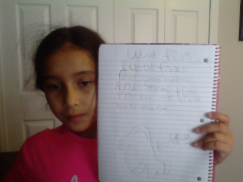
Chloe Francis

Slide 3
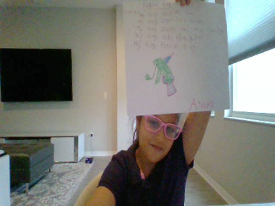
Anaya Gupta

Slide 4
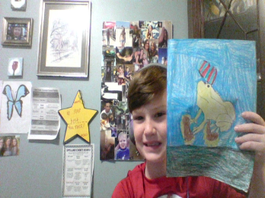
Andrew Holden

Slide 5
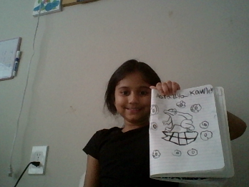
Aaradhya Kawley

Slide 6
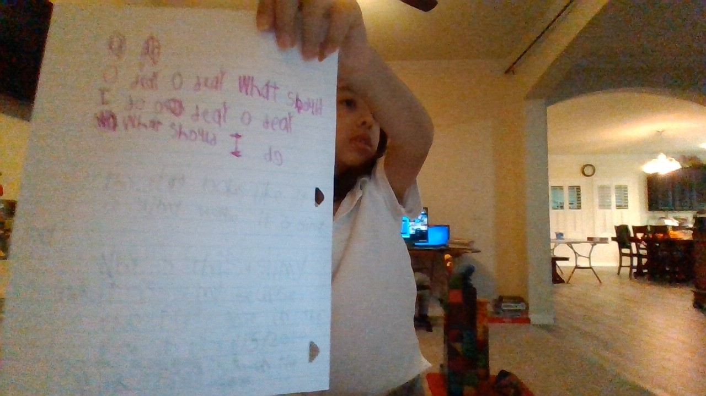
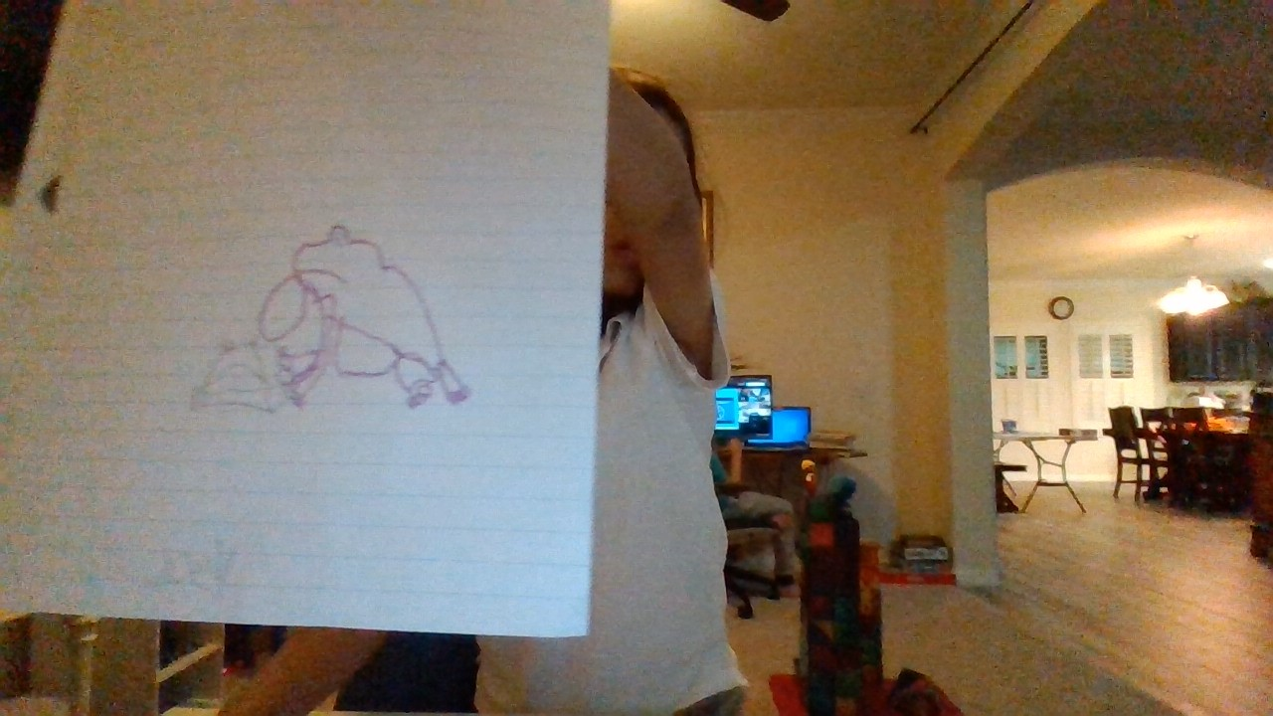
Joseph Leon

Slide 7
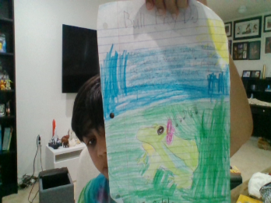
Shaurya Patel

Slide 8
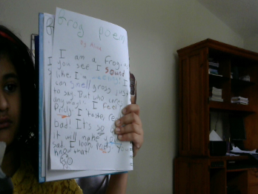
Alicia Thomas

Slide 9
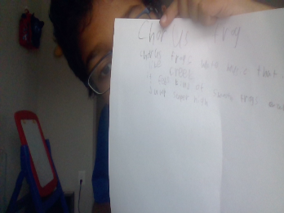
Arjun Vegesna

