Slide 1



Slide 2
Poetry Night with Wright Elementary
Have Fun Learning
What is poetry and prose?
How is poetry different than prose?
Observing your natural surroundings
5) Reading Poetry: Structure, meter and the importance of rhyme

Slide 3
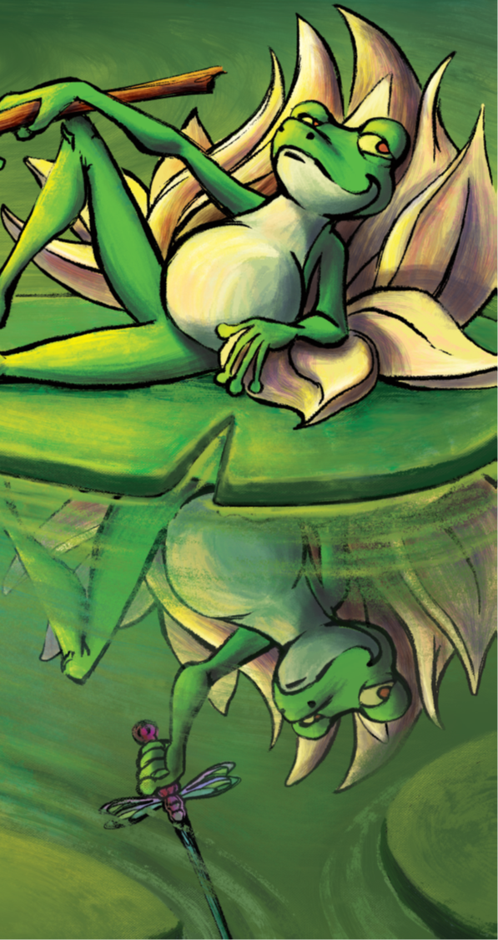
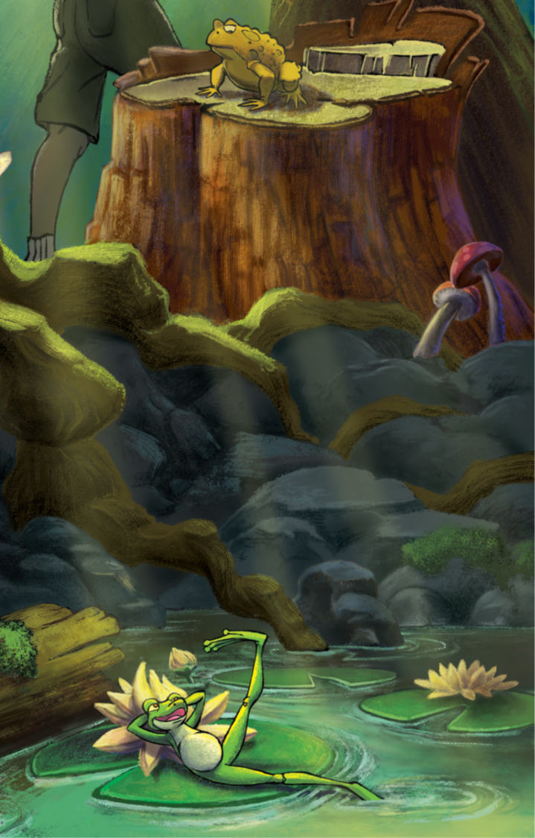

Slide 4
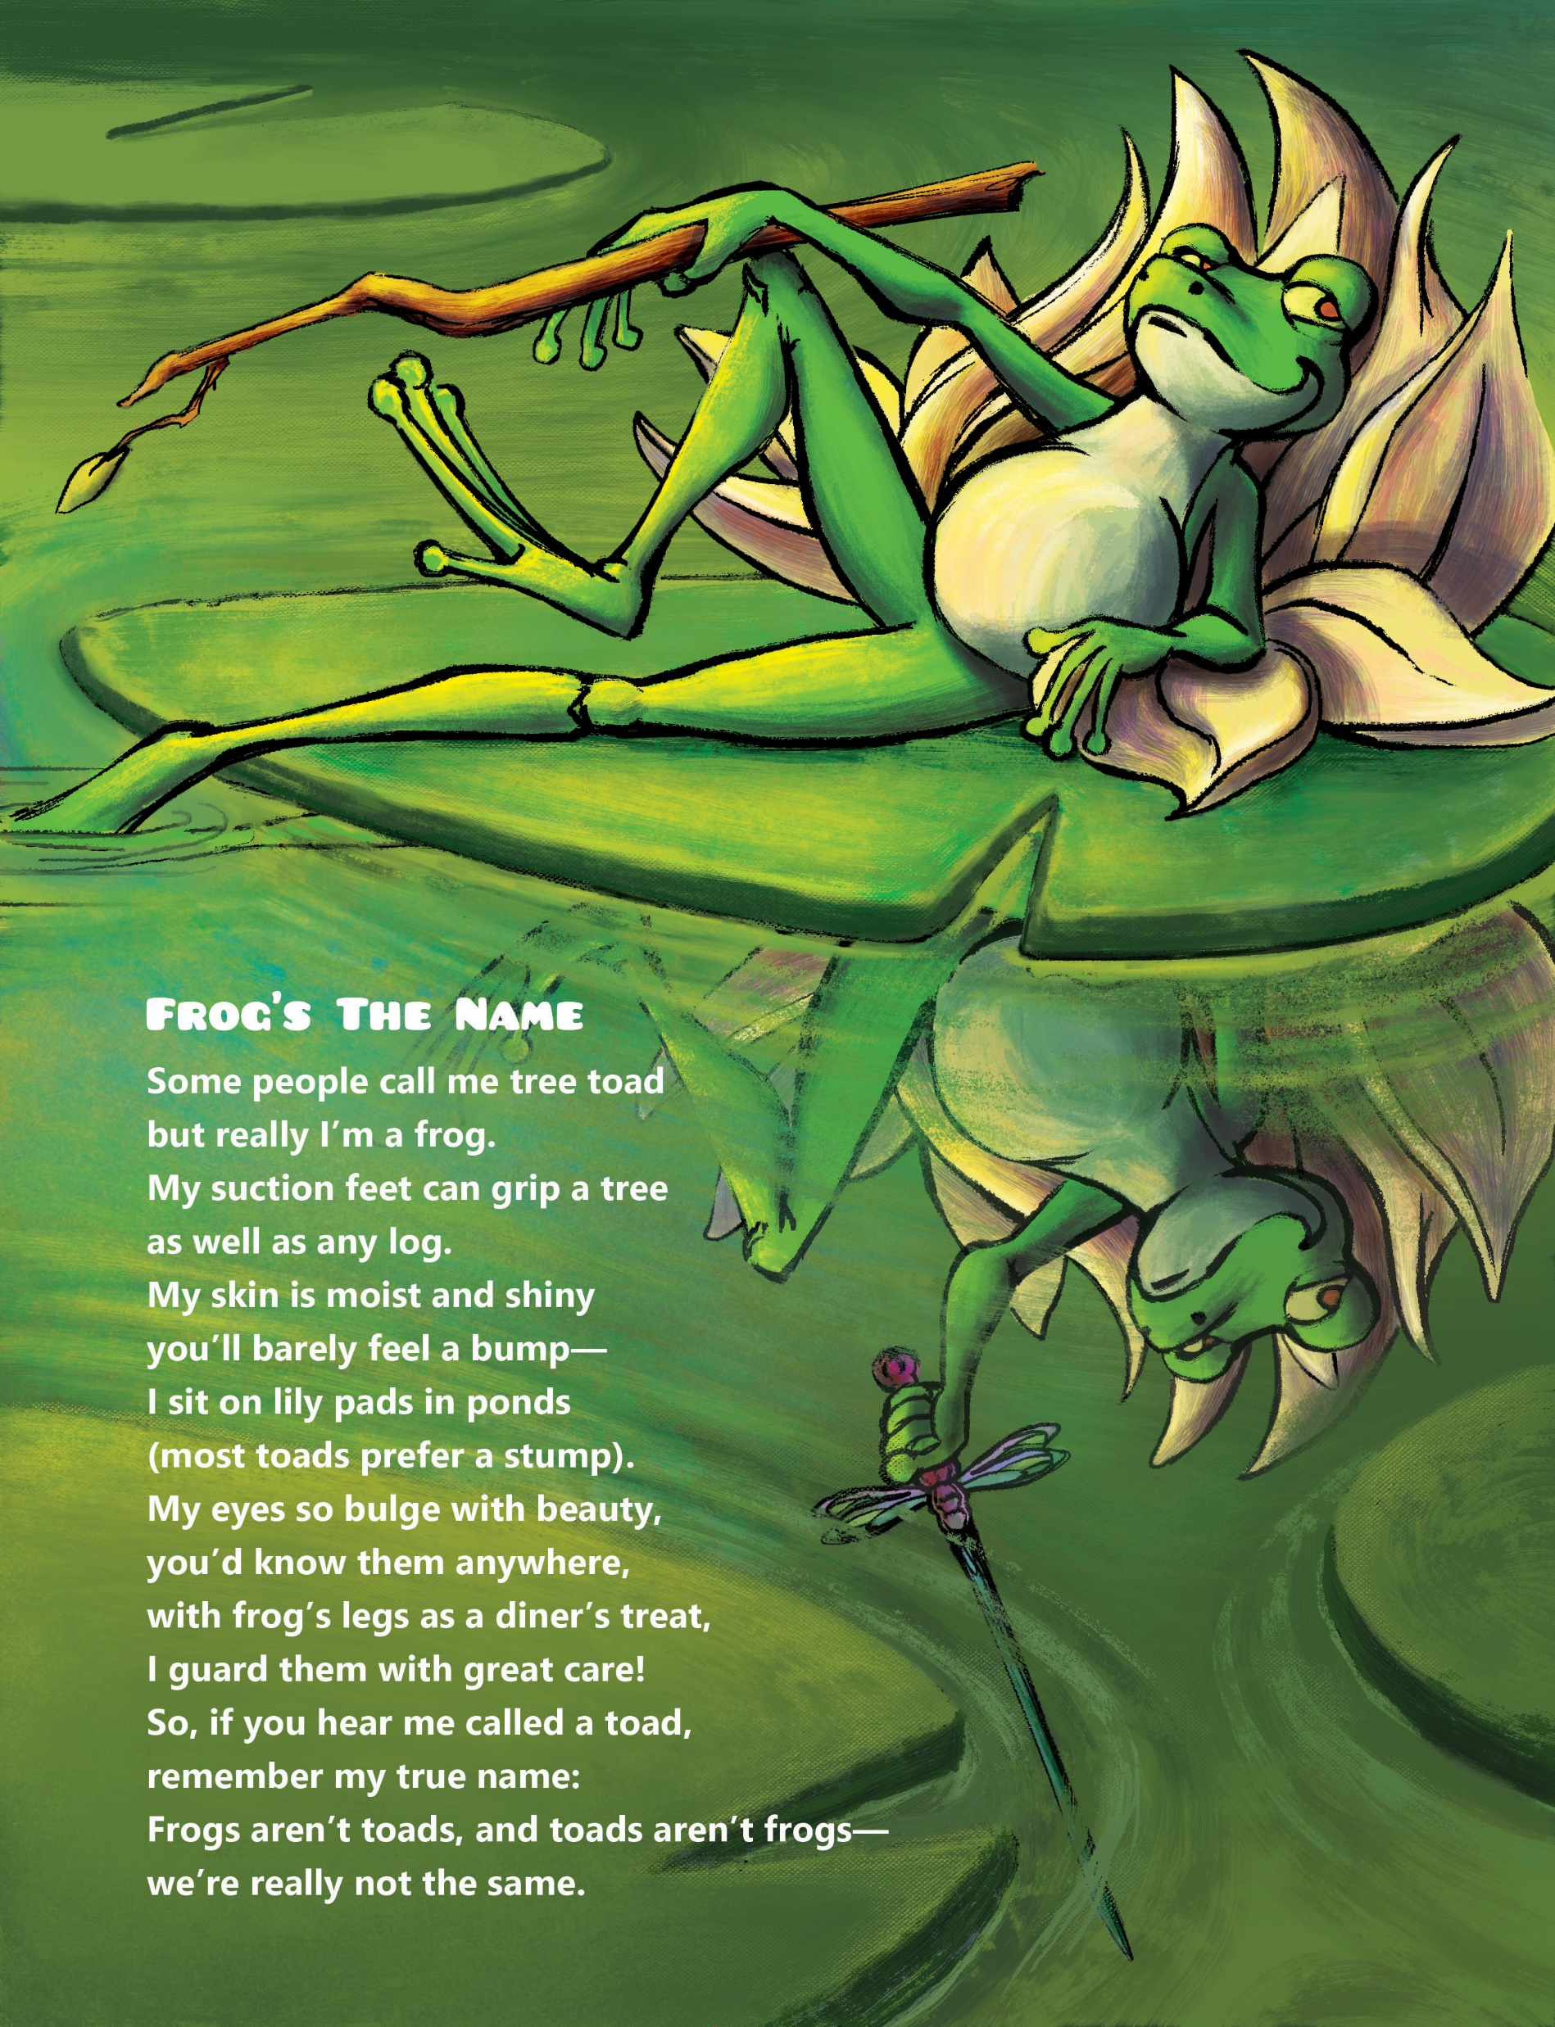

Slide 5
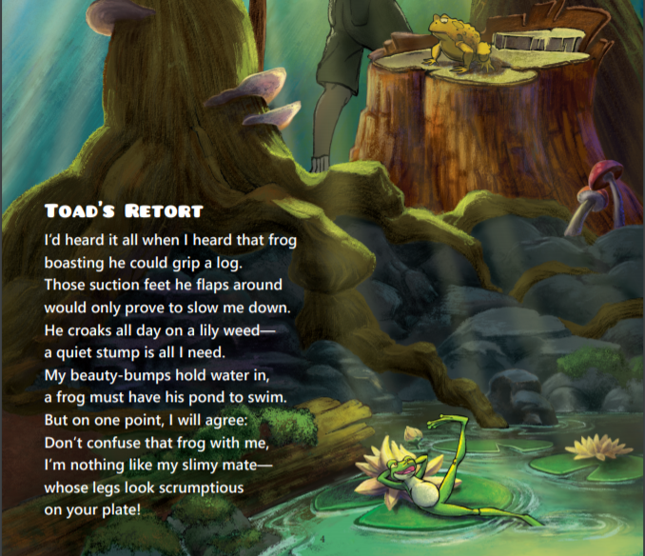

Slide 6
Frog’s The Name
Some people call me tree toad
but really I’m a frog.
My suction feet can grip a tree
as well as any log.
My skin is moist and shiny
you’ll barely feel a bump—
I sit on lily pads in ponds
(most toads prefer a stump).
My eyes so bulge with beauty,
you’d know them anywhere,
with frog’s legs as a diner’s treat,
I guard them with great care!
So, if you hear me called a toad,
remember my true name:
Frogs aren’t toads, and toads aren’t frogs—
we’re really not the same.
Toad’s Retort
I’d heard it all when I heard that frog
boasting he could grip a log.
Those suction feet he flaps around
would only prove to slow me down.
He croaks all day on a lily weed—
a quiet stump is all I need.
My beauty-bumps hold water in,
a frog must have his pond to swim.
But on one point, I will agree:
Don’t confuse that frog with me,
I’m nothing like my slimy mate—
whose legs look scrumptious
on your plate!

Slide 7
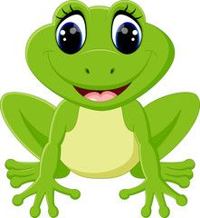
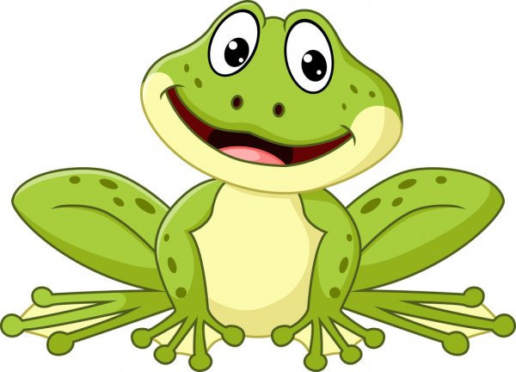
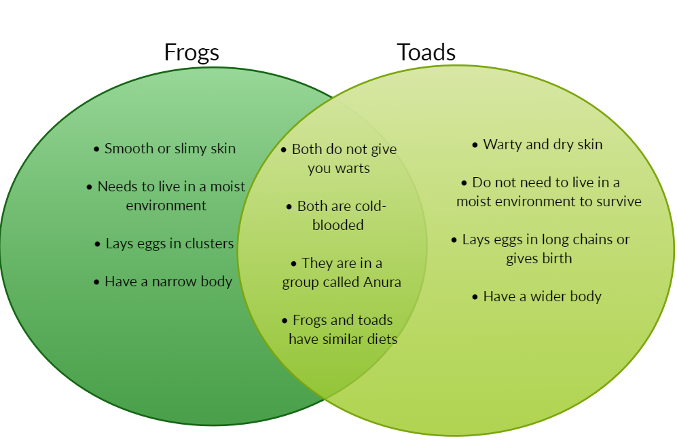

Slide 8

How to draw a frog
http://www.howtodrawanimals.net/how-to-draw-a-frog

Slide 9

https://Wonderopolis Frogs northeaternwith sound.com/calls-of-frogs-and-toads-of-the-northeast/

Slide 10
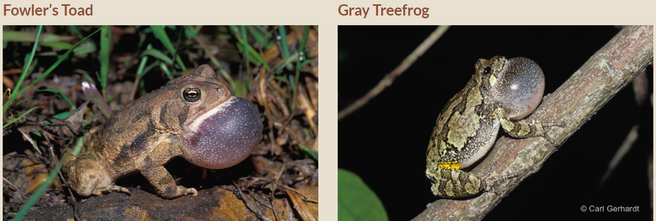
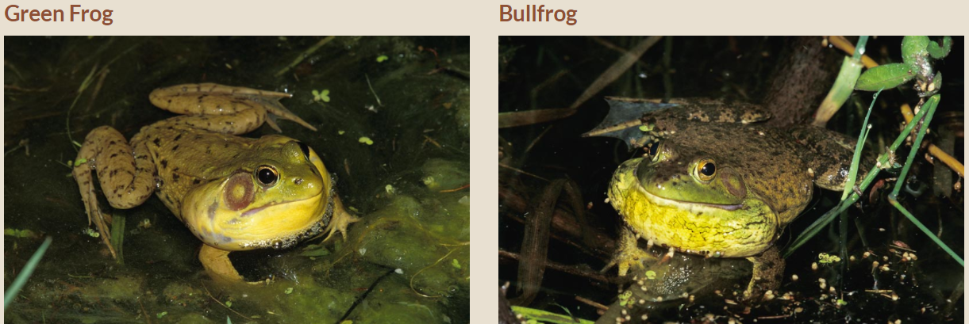
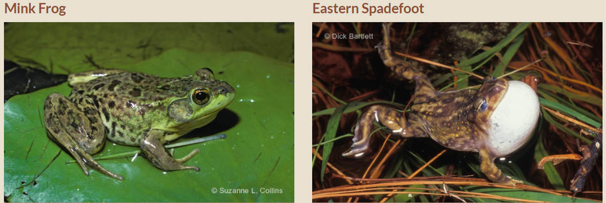

Slide 11
Hidden Pictures & Hidden Names
Bellyache
The Dream Swing
Scrump-De-Lee-Ishious
The Toothfairy

Slide 12
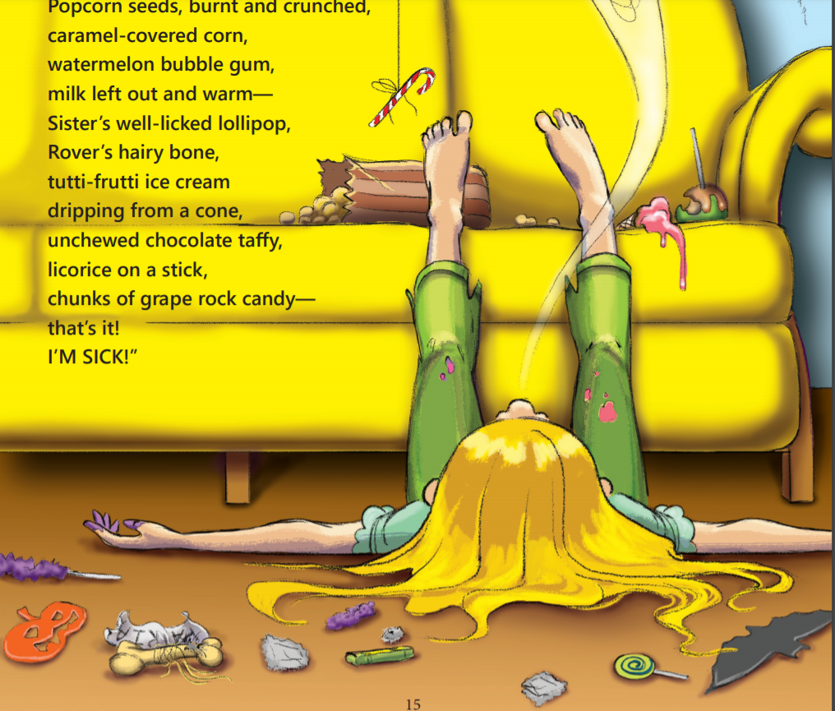

Slide 13
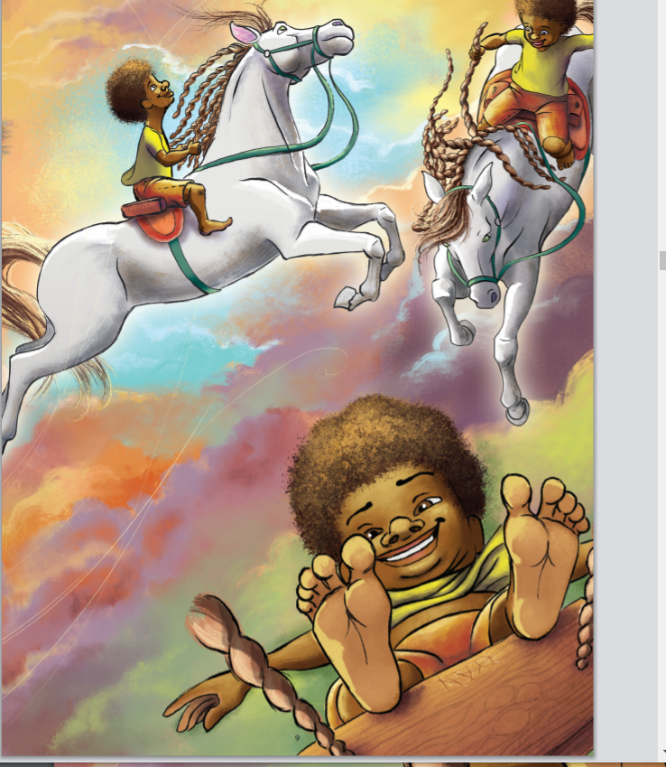

Slide 14
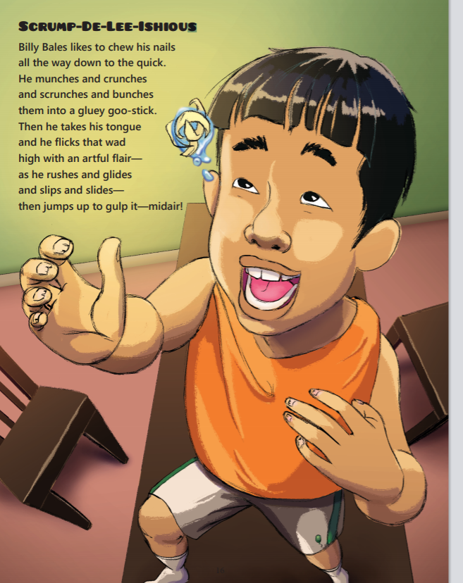

Slide 15
Tooth Fairy
“Why does the Tooth Fairy take your tooth?”
asked sensible Sally awaiting the truth.
Grandpa just grunted and sputtered and grumbled,
tried to speak, but only mumbled.
“Grandpa,” said Sally, “I know why you fret—
that Tooth Fairy came and took your whole set!”

Slide 16
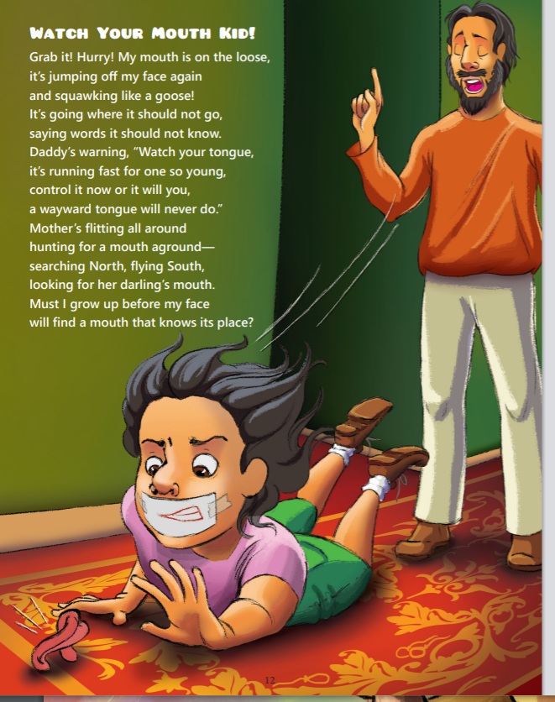

Slide 17
Loose Tooth
My tooth is loose! My tooth is loose!
Grinned Jenny late one night.
I’ll wiggle at it with my tongue—
then bend it back JUST RIGHT!
My yummy thumb will have to go
so I can twist my tooth—
I’ll turn it ‘round and ‘round and ‘round
till it feels R-E-A-L loose.
When that tooth’s about to drop—
just dangling from one root,
I’ll jam it back into my gums
and cry and howl and hoot.
I’ll puff up and stuff up
and scream until I faint,
to wake up weak and dizzy
till Mom hears my complaint.
The neighbors will come running—
they’ll stumble in their sleep
to ask Mom, “What’s the racket here?”
I’ll groan and roll and leap.
Dad will rush me to the dentist,
I’ll moan and kick and shout—
till I get that toy for being brave
when the dentist yanks it out!
18

Slide 18

Coming soon…

Slide 19
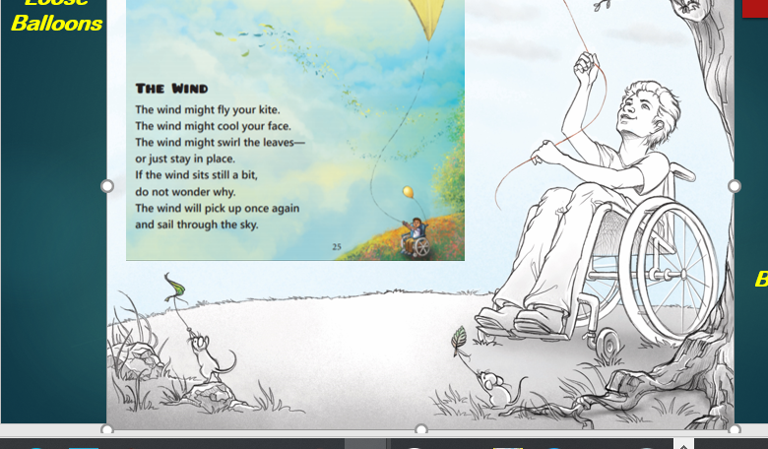

Slide 20
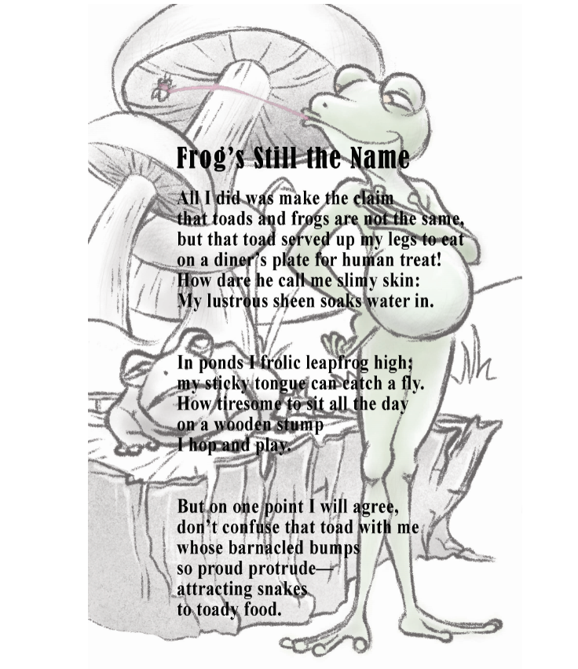

Slide 21
